Slide 1


AUTOMATIC LPG LEAKAGE INDICATOR
BATCH MEMBERS Batch mentor
Mohanaselvam S Dr S Saravanakumar M.E.,Ph.D.,
Sujith R
Naveenkumar M

Slide 2
ABSTRACT
This project presents the design and implementation of an LPG (Liquefied Petroleum Gas) Gas Detector integrated with an exhaust fan system for safety applications. The detector uses a gas sensor to continuously monitor the concentration of LPG in the surrounding air.
If the gas level exceeds a predefined threshold, an alarm is triggered, and the exhaust fan is activated to ventilate the area and reduce the risk of fire or explosion. This system enhances safety in environments where LPG is used, such as kitchens, laboratories, and industrial settings.
The project aims to provide an affordable, efficient solution for real-time gas leak detection and ventilation to protect individuals and property from potential hazards.

Slide 3
INTRODUCTION
Background:
LPG (Liquefied Petroleum Gas) is commonly used in households and industries. However, LPG leakage is a serious hazard that can lead to accidents, explosions, and fires.
Problem Statement:
Despite safety measures, leakage often goes unnoticed, causing potential harm to life and property.
Objective:
To design a system that detects LPG leakage and raises an alarm to alert people in the area.

Slide 4
LITERATURE SURVEY
LPG Gas Detection Systems:
Various gas detection technologies, such as semiconductor sensors, electrochemical sensors, and infrared sensors, have been explored for detecting LPG leaks. Semiconductor sensors, in particular, are widely used due to their cost-effectiveness and reliability in detecting flammable gases like LPG (source: R. S. Kumar et al., 2020).
Safety Standards and Protocols:
International safety standards, such as those outlined by NFPA (National Fire Protection Association) and ISO, emphasize the importance of gas detection systems with integrated ventilation in preventing accidents in domestic and industrial settings (source: ISO 10156:2020).
Arduino-based Solutions:
Recent studies show that Arduino-based LPG gas detection systems have gained popularity due to their low cost, flexibility, and ease of integration with additional components like alarms and fans. These solutions are ideal for low-cost safety projects in residential and commercial spaces (source: M. Patel et al., 2022).

Slide 5
Methodology
Data Acquisition:
The gas sensor continuously monitors the air for LPG concentration.
The analog output of the sensor is sent to the microcontroller for processing.
Threshold Detection:
The microcontroller compares the sensor data with a predefined LPG concentration threshold.
If the concentration exceeds the threshold, the microcontroller triggers the alarm and activates the exhaust fan.
Exhaust Fan Control:
Once activated, the exhaust fan runs until the gas concentration returns to safe levels.
The fan continues to run until the system resets, ensuring adequate ventilation.
Safety Protocol:
The system remains in standby mode when gas levels are normal.
Continuous monitoring ensures real-time detection and response to potential hazards.

Slide 6
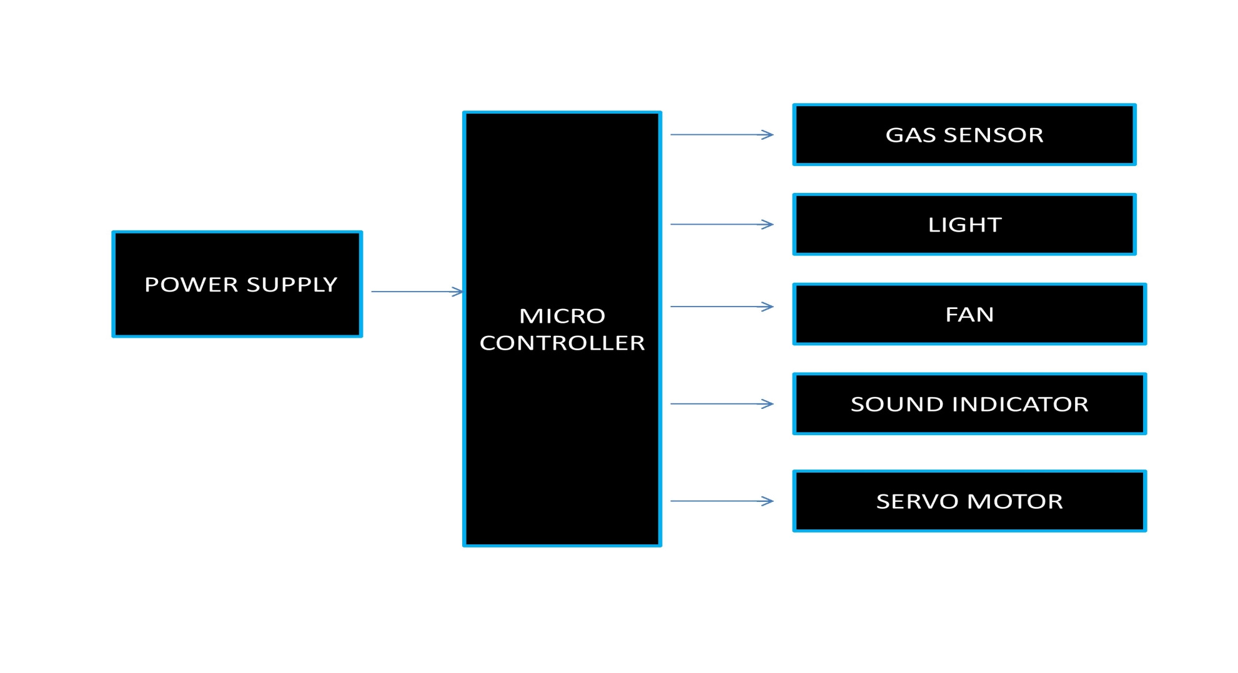
Block diagram

Slide 7
WORKING PRINCIPLE
Gas Sensors: Use of a gas sensor (e.g., MQ-6) to detect the presence of LPG in the air.
Microcontroller: The sensor data is sent to a microcontroller (e.g., Arduino) for processing.
Alarm Activation: If the gas concentration exceeds a threshold, the microcontroller triggers an alarm (buzzer, LED indicator).
Safety Measures: The system can also trigger a ventilation system or shut off the gas supply in advanced systems.

Slide 8
SYSTEM COMPONENTS
Gas Sensor (MQ-6): Detects the concentration of LPG in the air.
Microcontroller (Arduino Uno): Acts as the brain of the system, processing sensor data.
Buzzer: Provides an audio signal when LPG is detected.
LED Indicator: Lights up to indicate the status of leakage (e.g., red for leakage, green for safe).
Power Supply: 5V DC supply for the system.

Slide 9
Working of the System
Step 1: The gas sensor continuously monitors the air for LPG concentration.
Step 2: When LPG is detected, the sensor sends a signal to the microcontroller.
Step 3: The microcontroller processes the sensor signal and checks if the gas level is above a predefined threshold.
Step 4: If leakage is detected, the microcontroller activates the buzzer and LED indicator.
Step 5: The system continues to monitor until the gas level returns to safe levels.

Slide 10
Estimated Total Cost:

Slide 11
Advantages
Safety: Early detection of LPG leaks reduces the risk of accidents.
Cost-Effective: Simple and affordable system.
Easy to Implement: Based on widely available and inexpensive components like Arduino and MQ-6 sensor.
Real-Time Monitoring: Immediate feedback to alert individuals in case of gas leakage.

Slide 12
APPLICATION
Residential Kitchens:
Detects LPG leaks from cooking appliances and activates the exhaust fan to prevent gas buildup and reduce fire risk.
Industrial & Commercial Settings:
Ensures gas safety in factories, warehouses, and commercial kitchens by monitoring and ventilating LPG leaks automatically.
Laboratories:
Monitors gas concentrations in labs where LPG is used for experiments, ensuring a safe working environment by triggering alarms and ventilation when needed.

Slide 13
Conclusion
Summarize the key points:
The LPG Leakage Indicator is a simple, cost-effective solution for preventing hazardous gas leakage.
It ensures safety in households, industries, and other spaces where LPG is used.
Highlight the importance of such systems in ensuring public safety.

Slide 14
THANK YOU…

